Slide 1
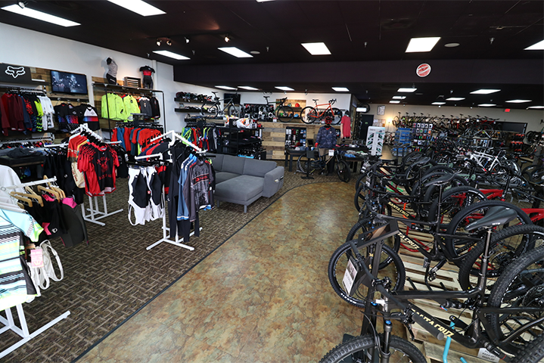
Bicycle Shop
Erik Shahverdian
Christian Pimentel
Benjamin Lozano
Jeffrey Guardado
Luis Rodriguez

Slide 2
Brief Description Of The Shop
The database system records the inventory of the products from the warehouse while also storing the details of the products. As well as storing data on repairs, shipments and current employees.

Slide 3
Business Rules
In our bike shop we have a storefront with a repair shop and warehouse. In each of these facilities we have designated employees for each role. The storefront contains different types of bikes and accessories (quantities, item types and prices) which are provided by the warehouse through shipments (with date of shipment is received, shipping cost, quantity of boxes shipped) and the storefront creates repair orders to send to the repair shop which detail the repair type and the bikeID to be worked on.

Slide 4
Entities And Their Relationships
Storefront - (M : 1) - Shipment (Many shipments to one storefront)
Storefront - (M : 1) - Employee (Many employees to one storefront)
Storefront - (M : 1) - Accessories (Many accessories to one storefront)
Storefront - (M : 1) - Bike (Many bikes to one storefront)
Storefront - (1: M) - Repair Shop (Many bikes sent to one repair shop)
Shipment - (1 : M ) - Warehouse (Many shipments to one warehouse)
Repair Shop - ( 1 : M ) - Bike (Many bikes to one repair shop)
Employee - ( 1 : M ) - Warehouse could contain multiple employees
Accessory - ( 1:M ) - Warehouse has many different accessories in one warehouse
Bike - (1:M ) - Warehouse as many bikes can be in the same warehouse
Repair Shop - ( 1:M ) - Employee (Many employees to one repair shop)

Slide 5
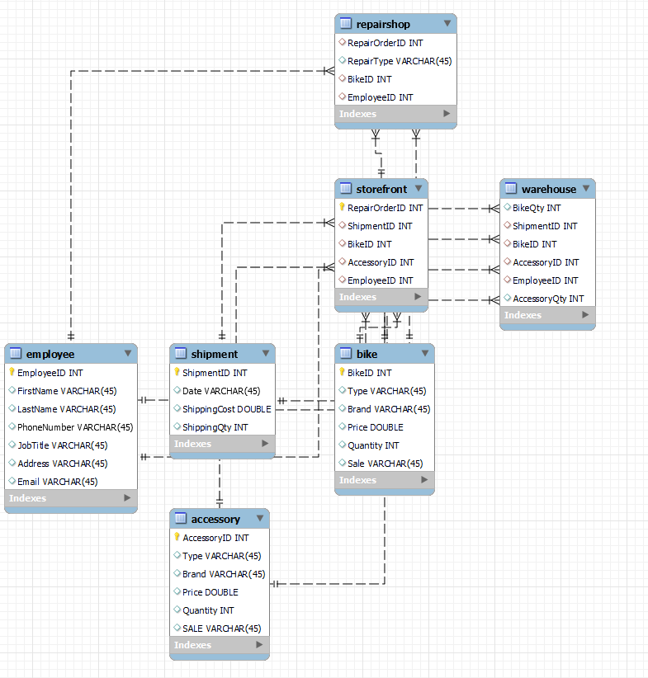
ERD Model

Slide 6
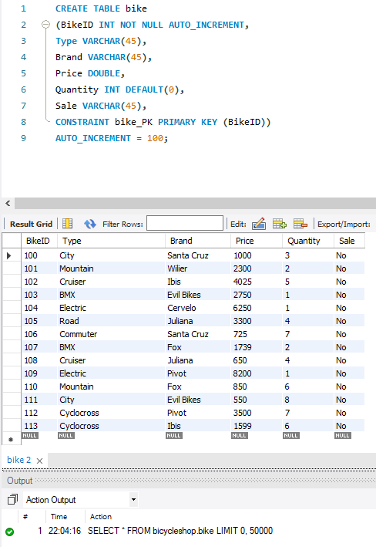
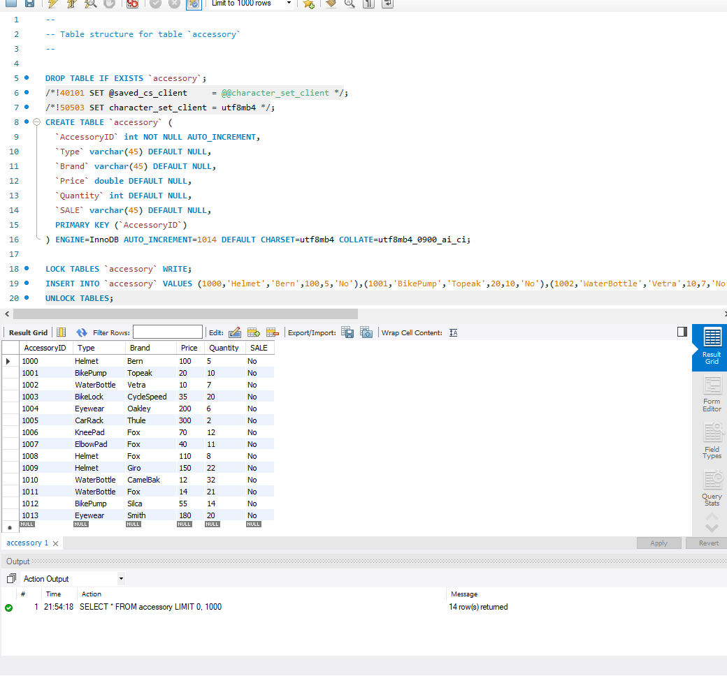
Tables
Accessory
Bike

Slide 7
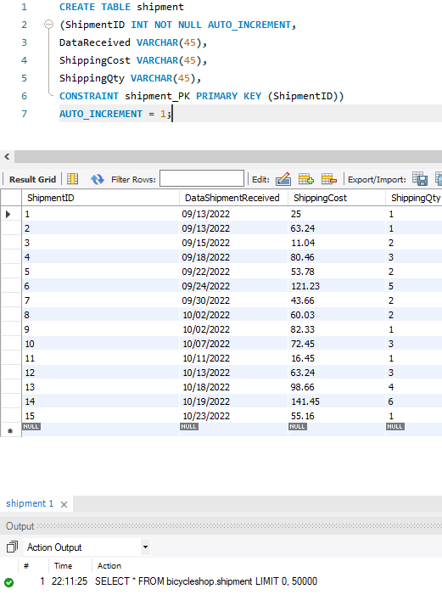
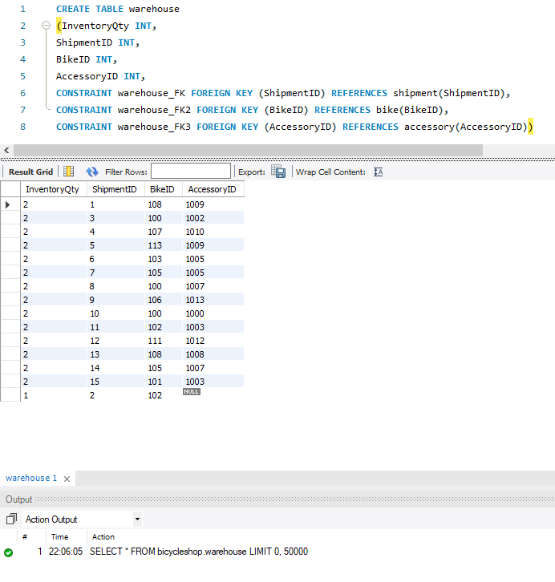
Tables (cont.)
Store Front
Warehouse

Slide 8
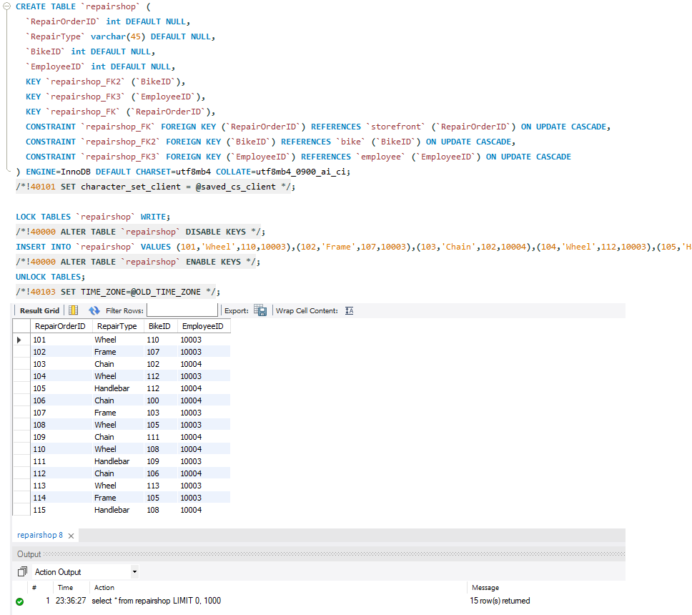
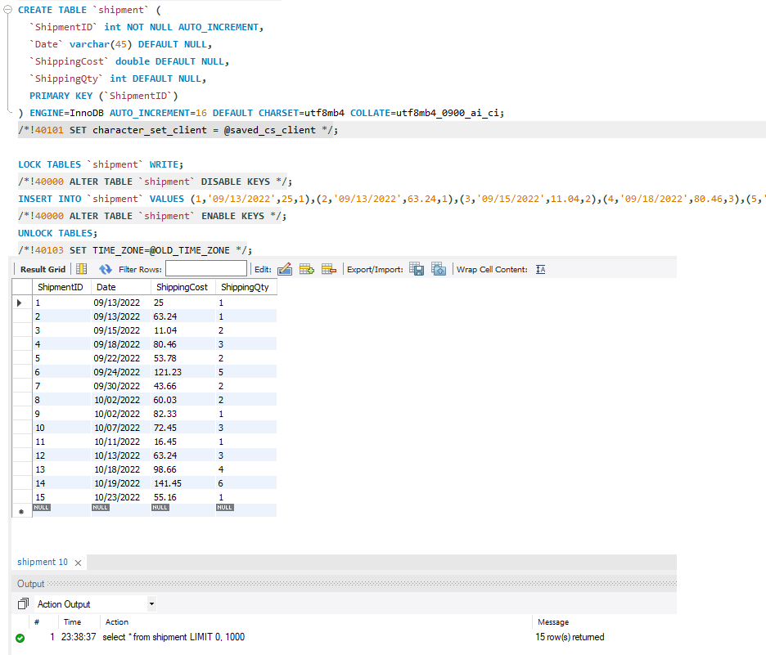
Tables (cont.)
Repair Shop
Shipment

Slide 9
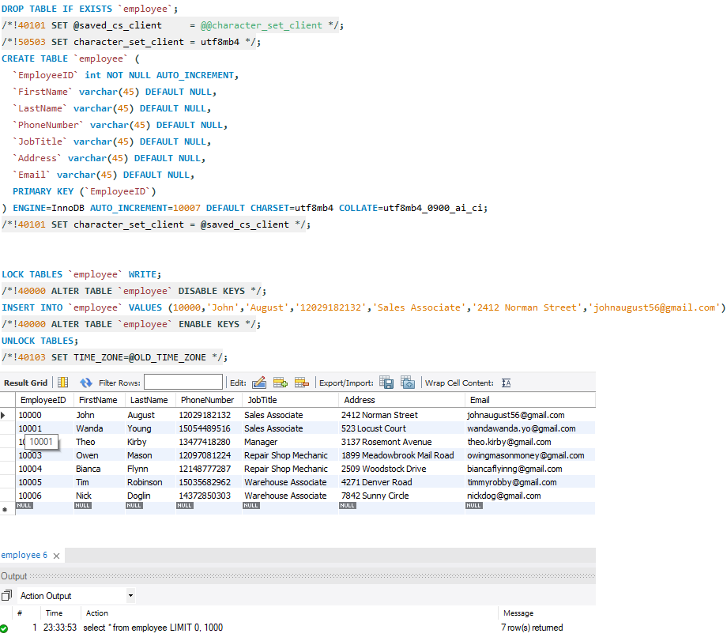
Tables (cont.)
Employee

Slide 10
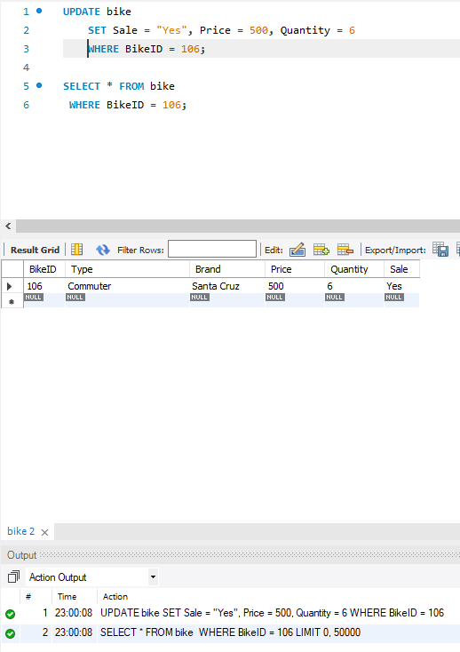
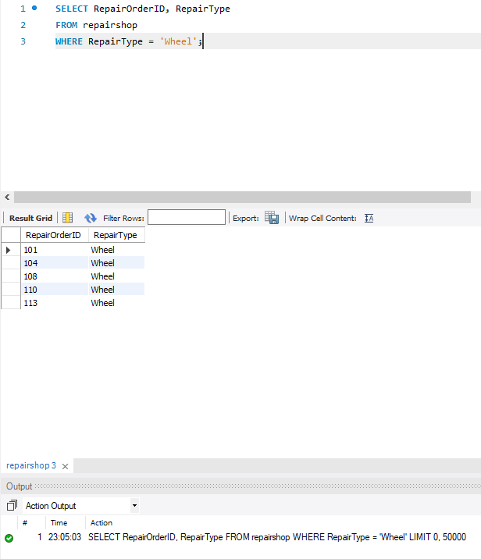
Queries
Updating Bike Details
Showing Repair Orders for Wheels

Slide 11
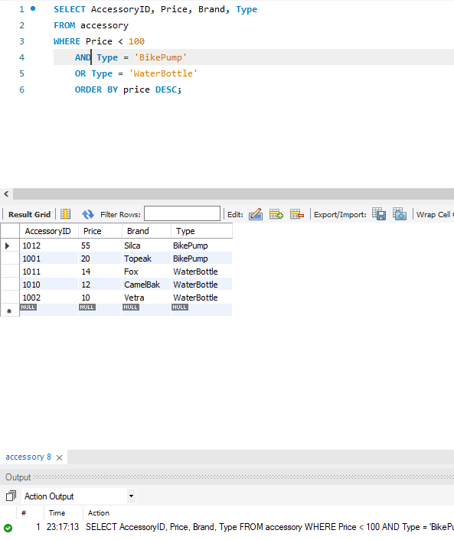
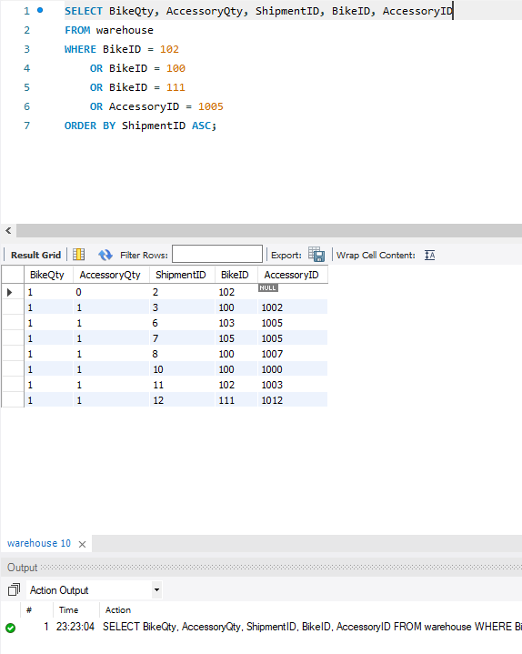
Queries (cont.)
Bike Pump & Water Bottles That Cost Under $100
Shipments That Has Certain Bikes and Accessories

Slide 12
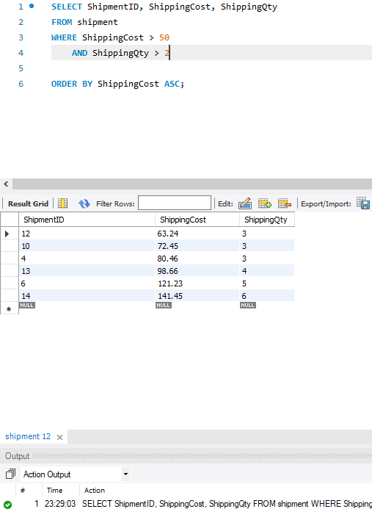
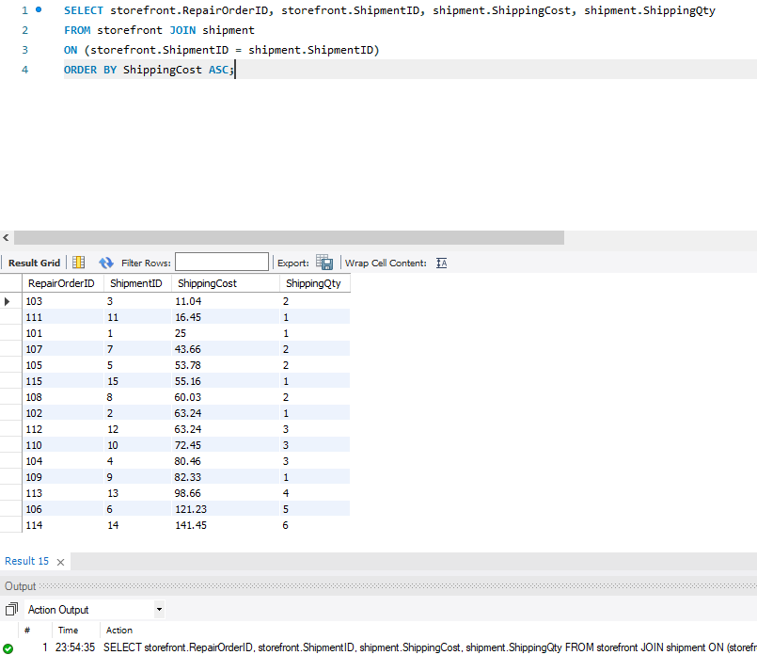
Queries (cont.)
Shipments That Cost More Than $50 & Contain More Than 2 Items
Shipments Through The Store Front & How Much They Cost

Slide 13
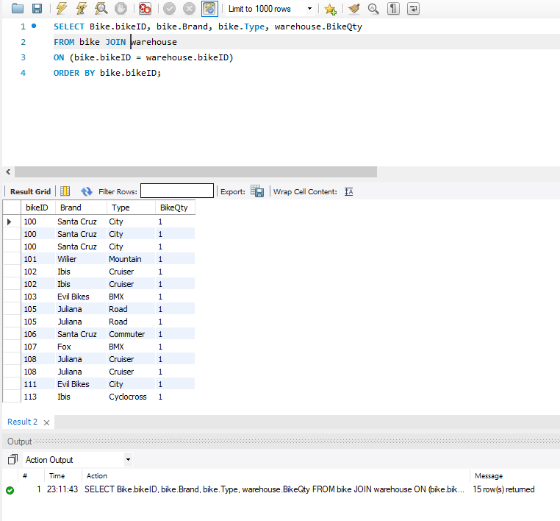
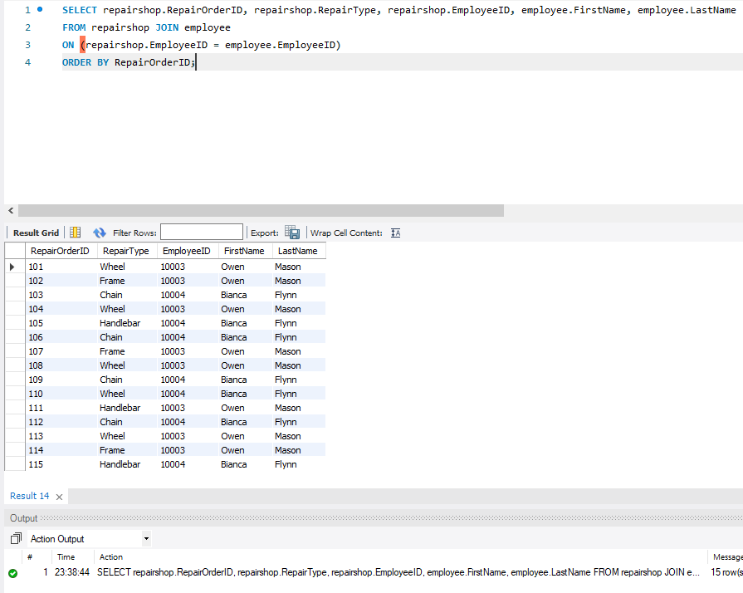
Join Queries (cont.)
Getting quantity of bikes from warehouse
Join employee information with repair order

Slide 14
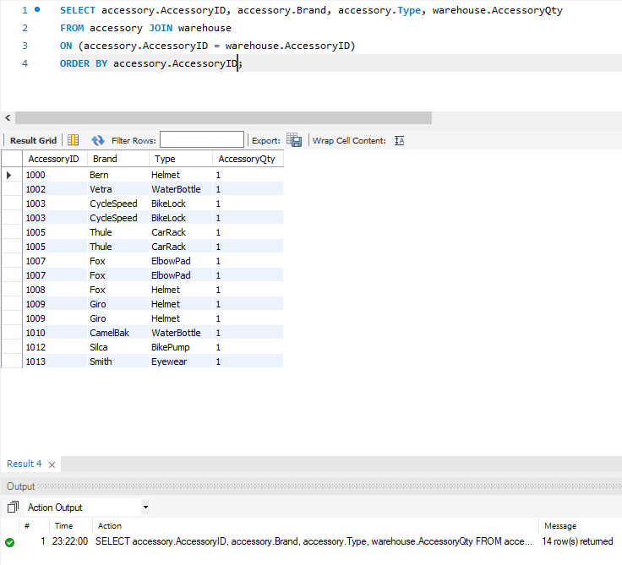
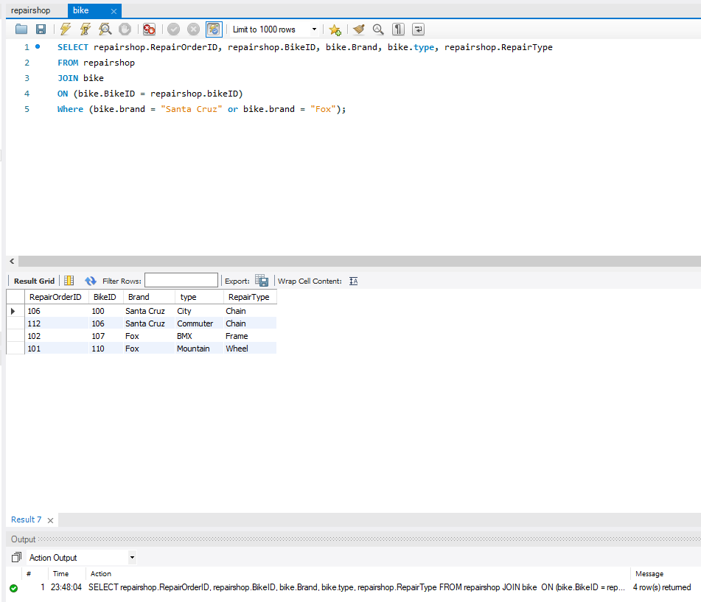
Join Queries (cont.)
Getting quantity of Accessories from warehouse
Join to find repair types for Fox, SantaCruz bikes

Slide 15
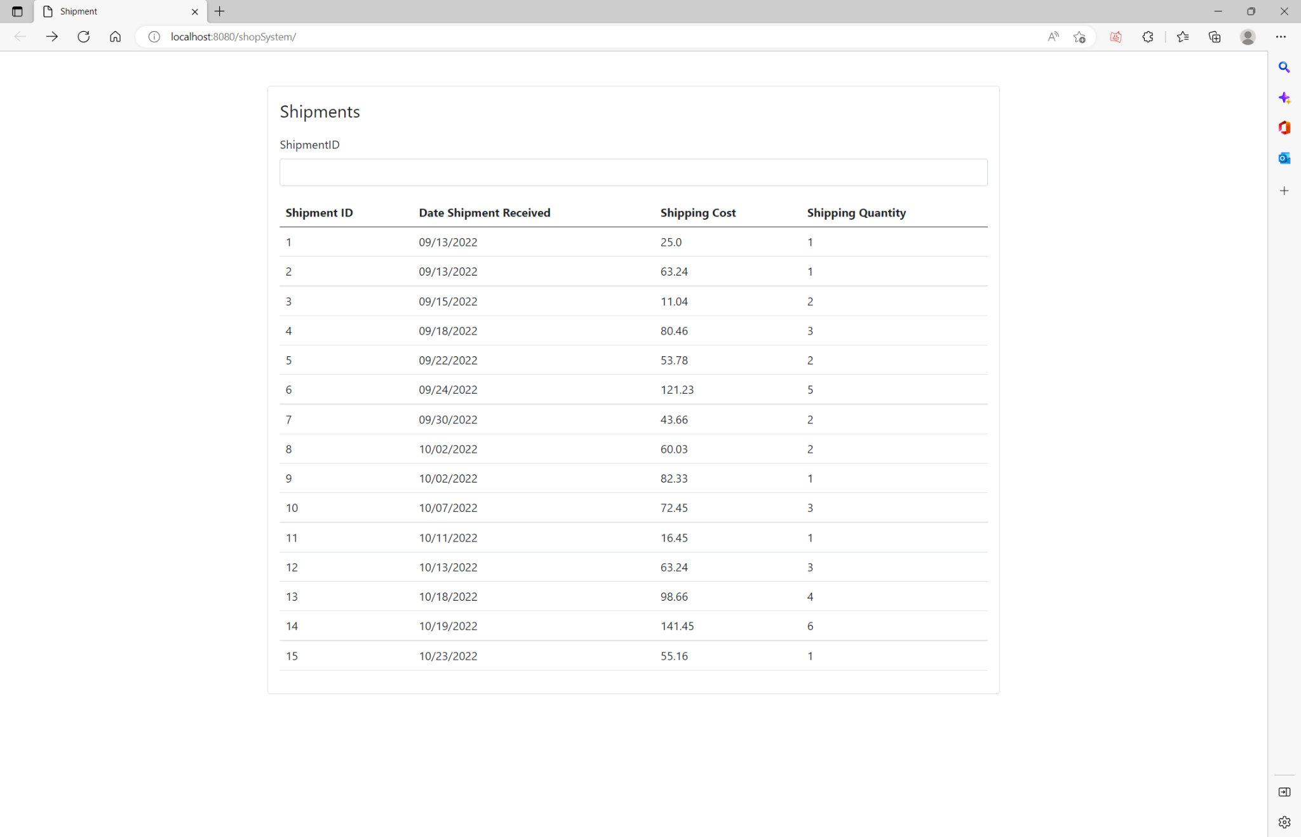
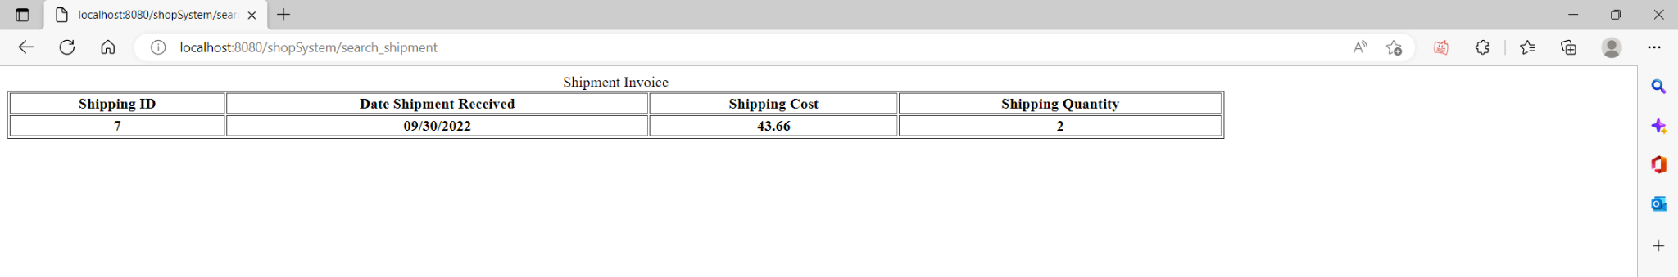
JDBC
Maven Web Application Using The Eclipse IDE
Connected Web Application to MySQL with JDBC
We can see all of the Shipments and When we type in a Shipment ID, a shipment invoice will display
This is done using a java servlet to communicate with the user input

